Slide 1
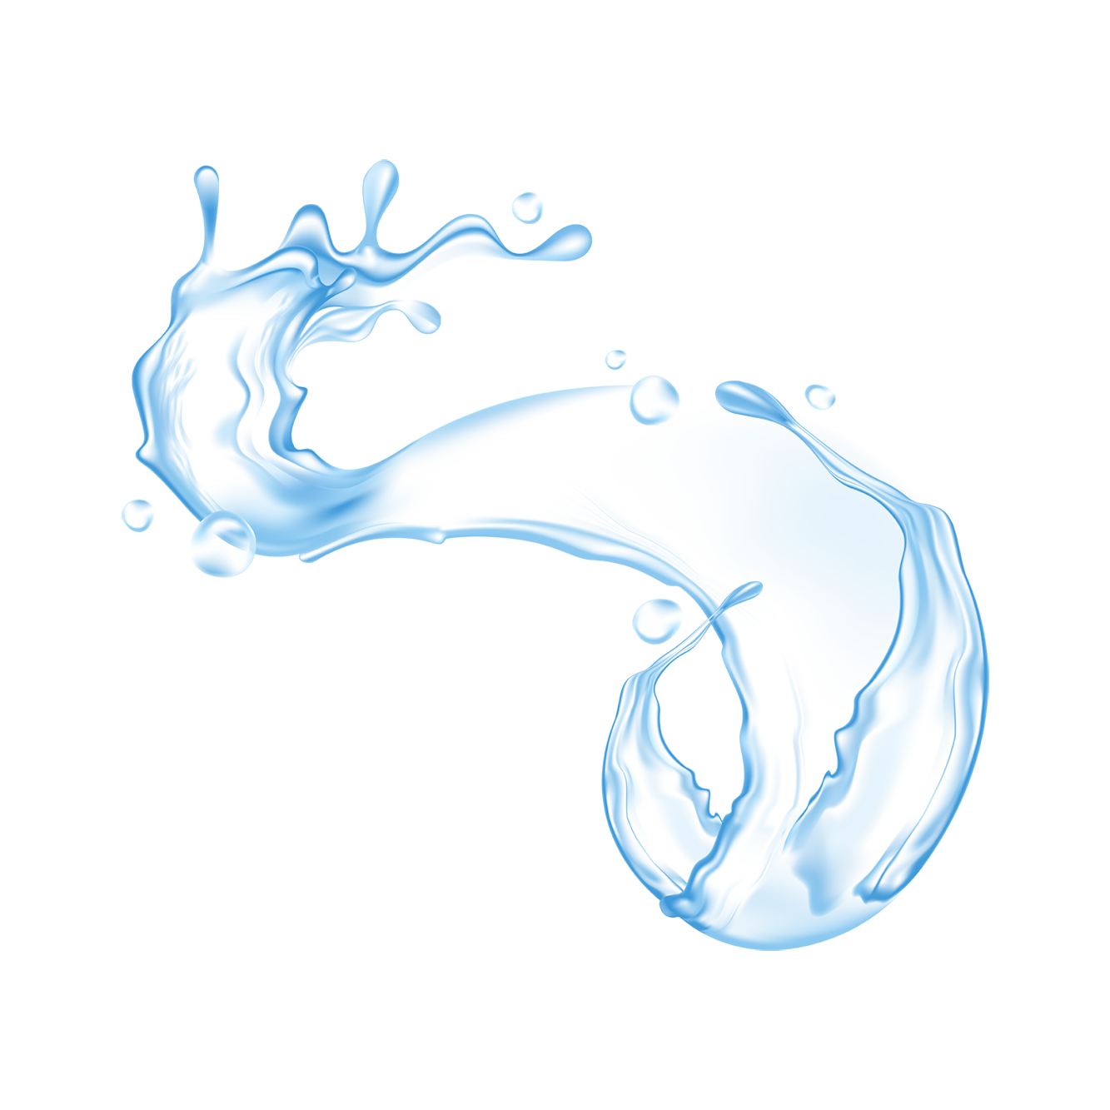
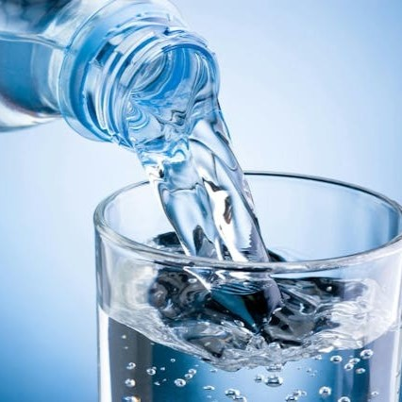

WATER
The another name of Life

Slide 2
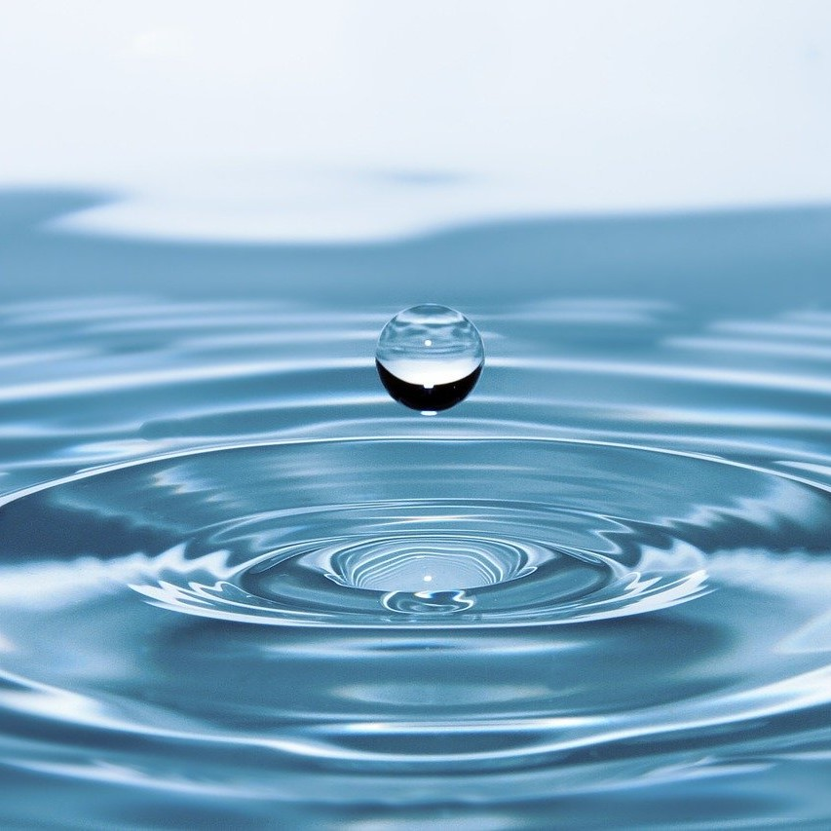
Water (H2O)
Covers 71% of Earth's surface and is vital for all living organisms.
Water makes up about 60-70% of the human body and is vital for all living organisms to survive and thrive.
Covers 71% of Earth's surface, playing a critical role in maintaining the planet's ecosystems and climate.
"Water is life’s matter and matrix“
- Albert Szent-Gyorgyi

Slide 3
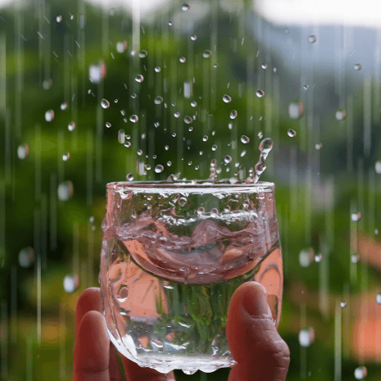
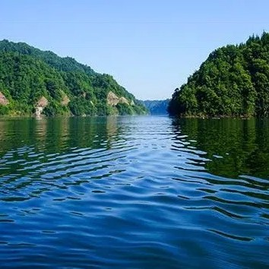
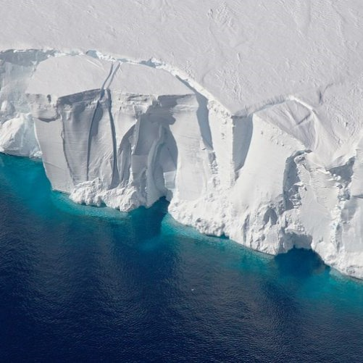
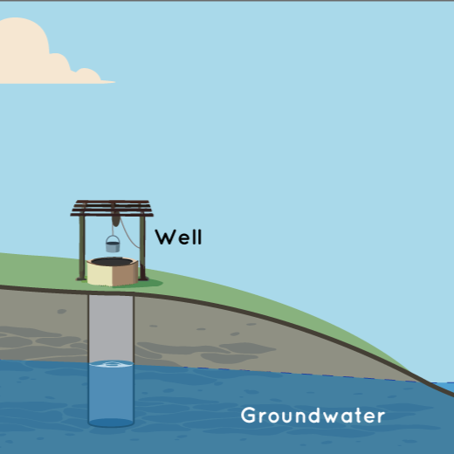

Types of Water Resources
Surface water
Rainwater
Glaciers and ice caps.
Groundwater

Slide 4
Distribution of water on earth

Slide 5
Water Cycle
Evaporation
Condensation
Precipitation
Runoff
Infiltration

Slide 6
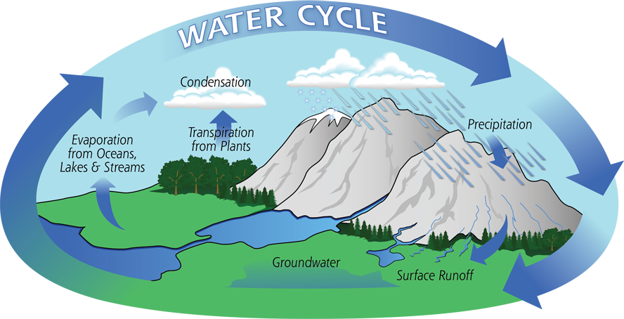

Slide 7

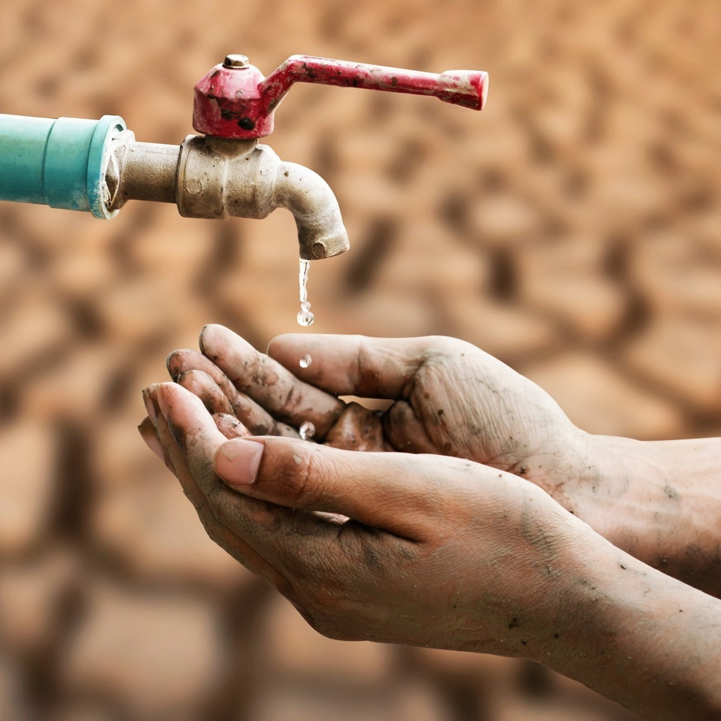
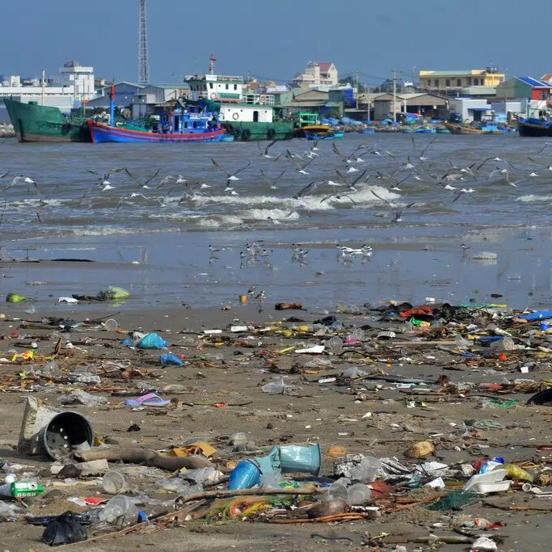
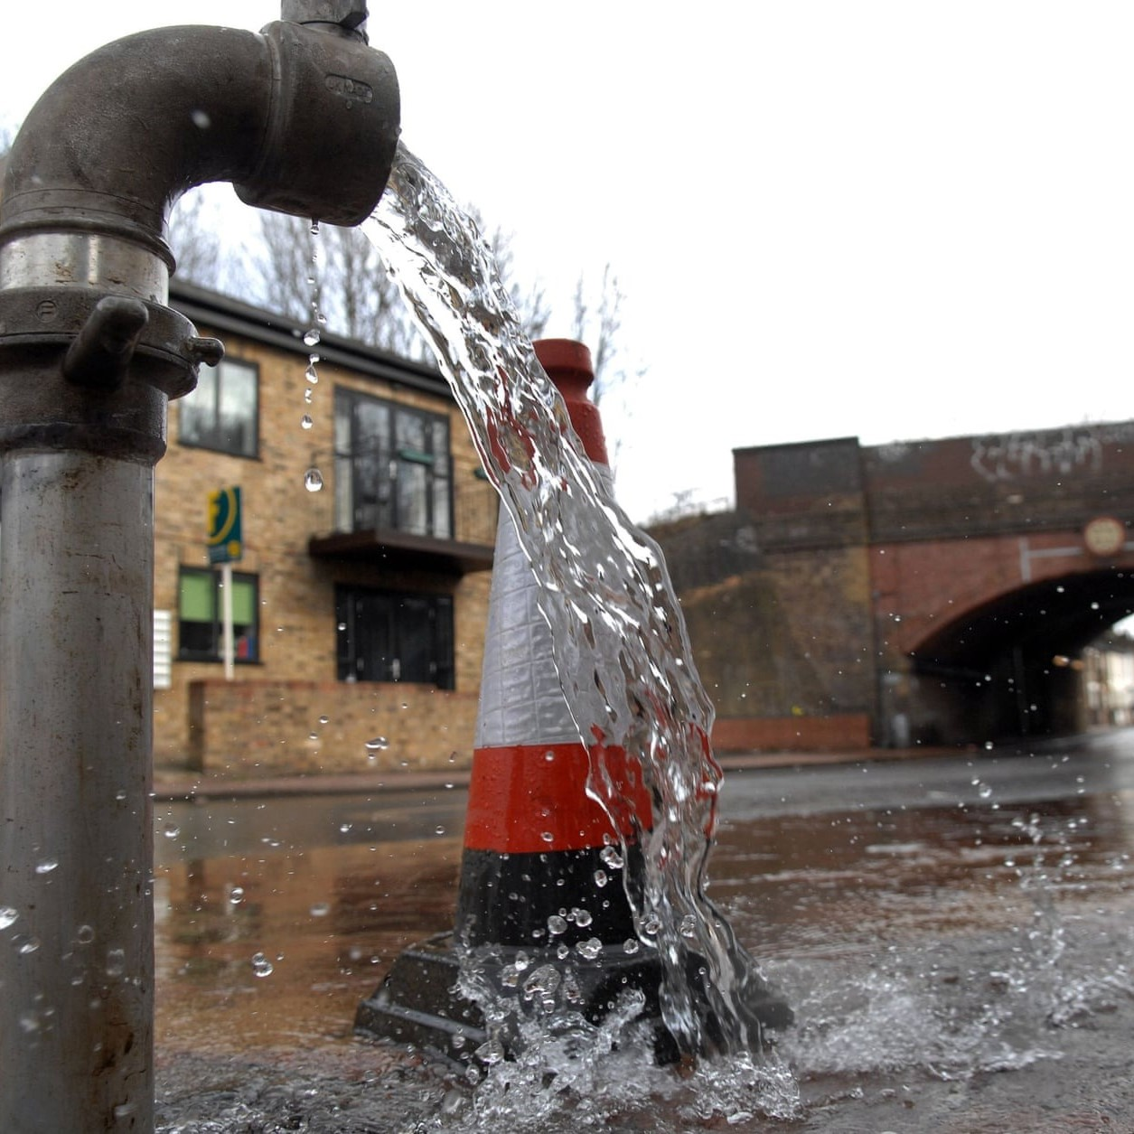
Challenges and Issues
Water scarcity
Water Pollution
Overuse and wastage.

Slide 8
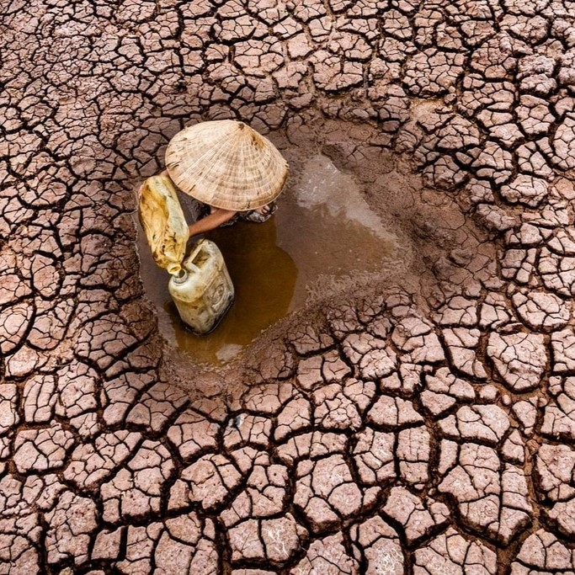
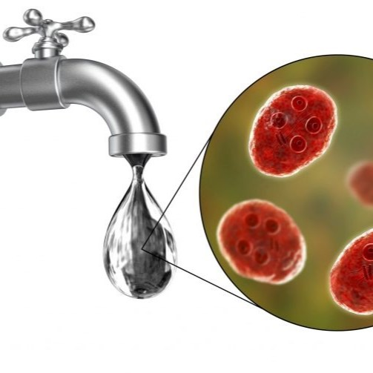
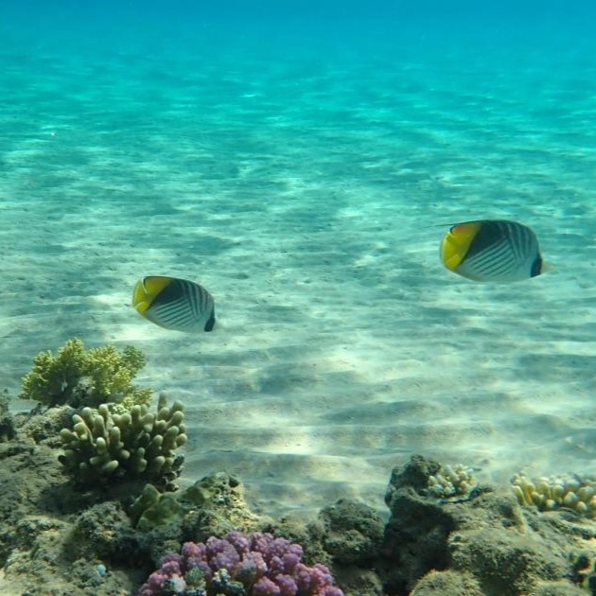
Effects of Water Pollution
Increases droughts
Waterborne Diseases
Loss of Biodiversity

Slide 9
Solutions to Water Challenges
Improved Wastewater Treatment
Sustainable Agricultural Practices
Protection of Water Ecosystems
Recycling and Reuse
Climate Change Adaptation

Slide 10
THANK YOU

